Slide 1
CIS CONTROL 17: SECURITY AWARENESS & TRAINING-I
IMPLEMENT A SECURITY AWARENESS & TRAINING PROGRAM

Slide 2
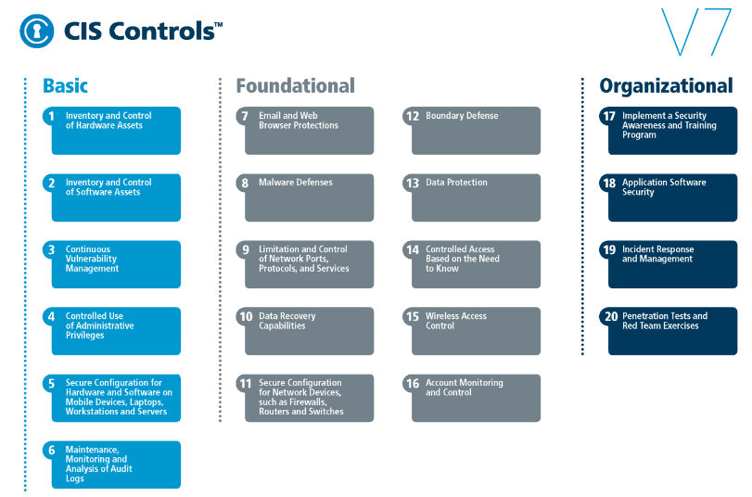
CIS CONTROL 17: SECURITY AWARENESS & TRAINING-I
https://www.cisecurity.org/controls/

Slide 3
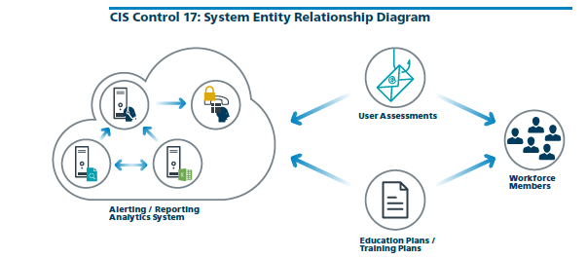
CIS CONTROL 17: SECURITY AWARENESS & TRAINING-I
https://www.cisecurity.org/controls/

Slide 4
CIS CONTROL 17: SECURITY AWARENESS & TRAINING-I
17.1: Perform a Skills Gap Analysis
Perform a skills gap analysis to understand the skills and behaviors workforce members are not adhering to, using this information to build a baseline education roadmap.

Slide 5
CIS CONTROL 17: SECURITY AWARENESS & TRAINING-I
17.2: Deliver Training to Fill the Skills Gap
Deliver training to address the skills gap identified to positively impact workforce members' security behavior.

Slide 6
CIS CONTROL 17: SECURITY AWARENESS & TRAINING-I
17.3: Implement a Security Awareness Program
Create a security awareness program for all workforce members to complete on a regular basis to ensure they understand and exhibit the necessary behaviors and skills to help ensure the security of the organization.

Slide 7
CIS CONTROL 17: SECURITY AWARENESS & TRAINING-I
17.3: Implement a Security Awareness Program
The organization's security awareness program should be communicated in a continuous and engaging manner…

Slide 8
CIS CONTROL 17: SECURITY AWARENESS & TRAINING-I
17.4: Update Awareness Content Frequently
…Ensure that the organization's security awareness program is updated frequently (at least annually) to address new technologies, threats, standards and business requirements.
END

